Slide 2
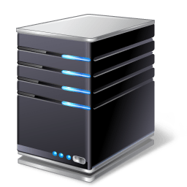
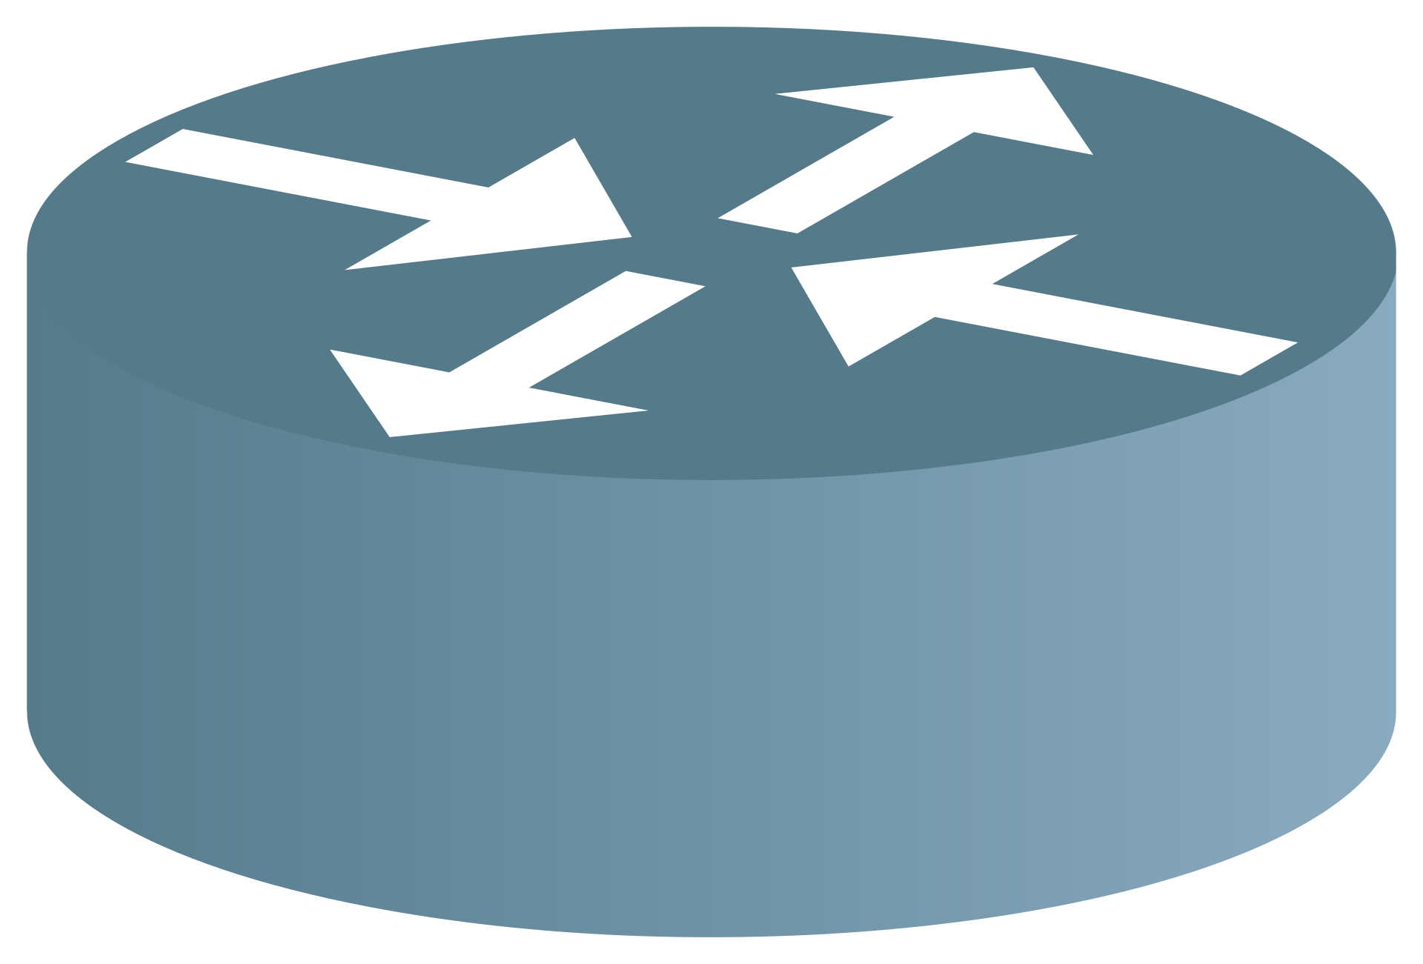

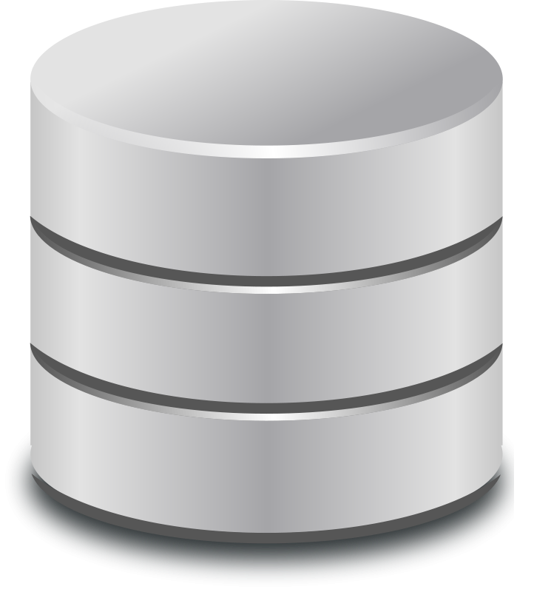
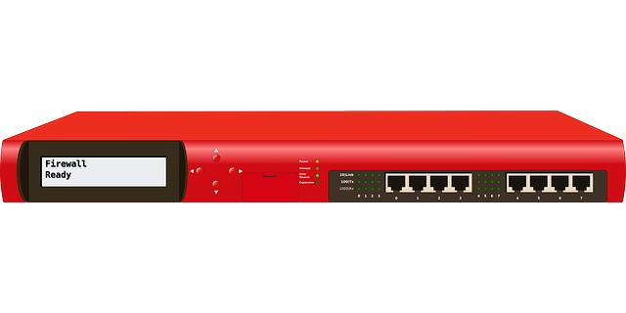
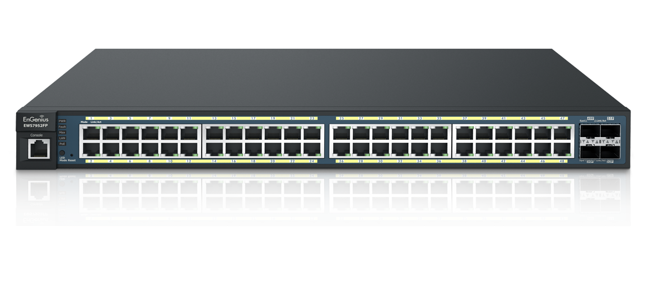
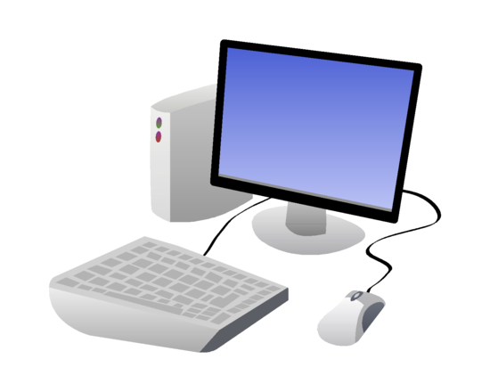

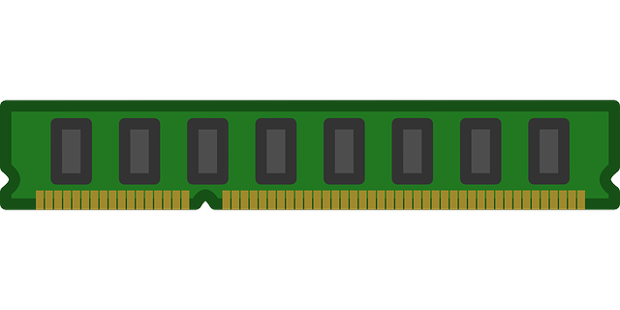
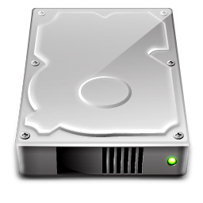
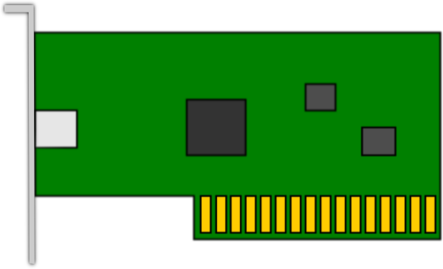
Cloud Computing
Delivery of computing services over the Internet
This Photo by Unknown Author is licensed under CC BY-SA

Slide 3

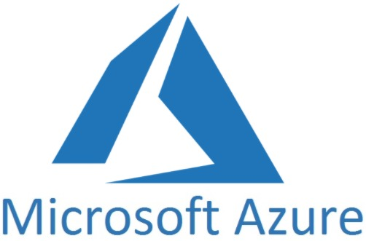
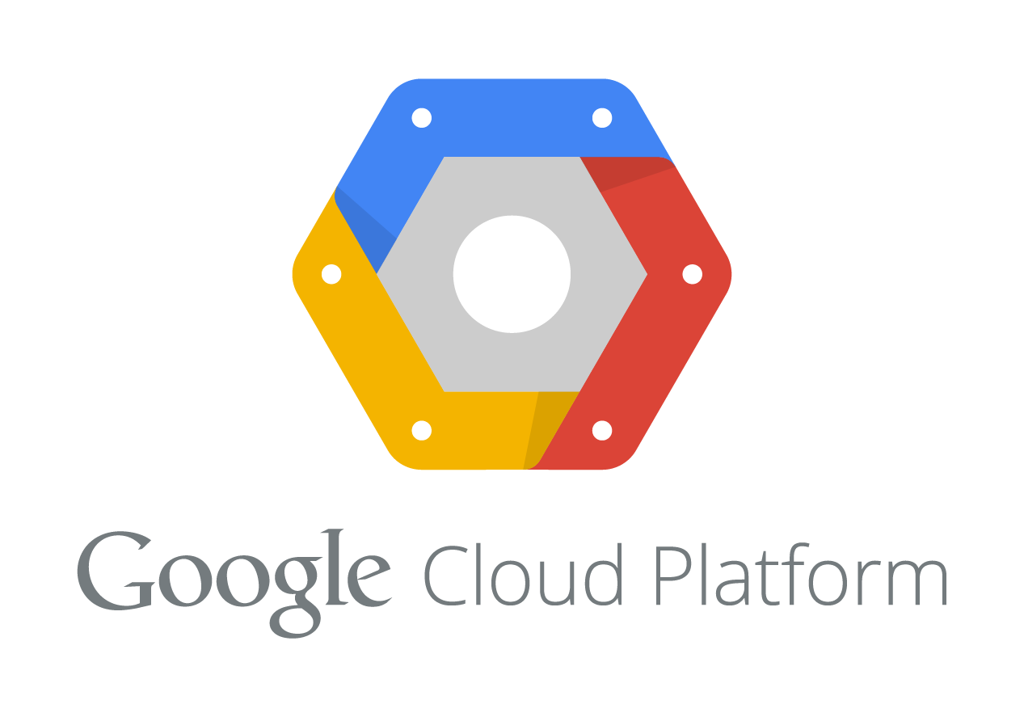
Cloud Service Provider
Organization providing cloud computing services
Notes:
https://azure.microsoft.com/en-us/solutions/
https://aws.amazon.com/
https://cloud.google.com/

Slide 4

Tenant, Multi-tenant, Tenant Isolation
A single customer or multiple customers within a cloud providers network
Company 1
Company 2
Company 3
Notes:
https://azure.microsoft.com/en-us/solutions/
https://aws.amazon.com/
https://cloud.google.com/

Slide 5
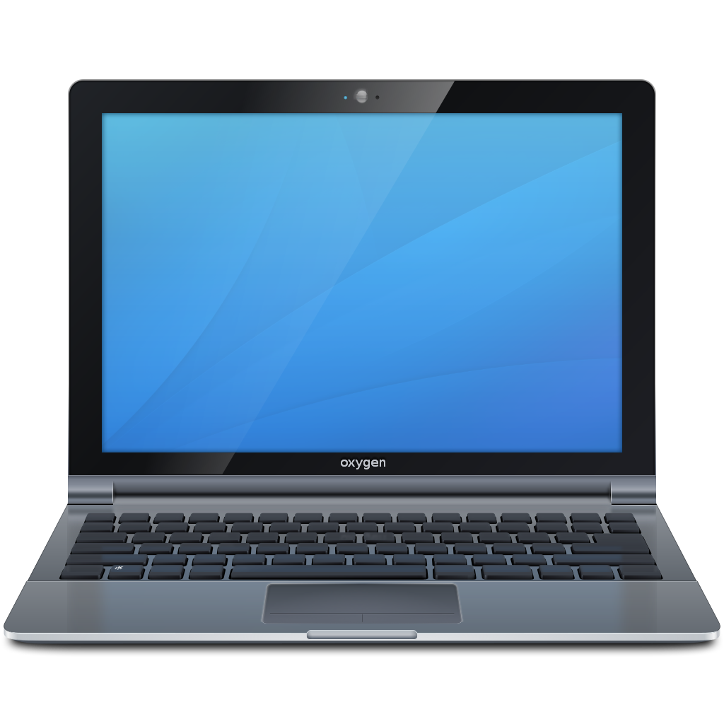


On-Demand Self-service
Applications
Notes:
Users can access computing services via the cloud when they need to without interaction from the service provider. The computing services should be fully on-demand so that users have control and agility to meet their evolving needs.

Slide 6


Broad Network Access
Applications
Notes:
Cloud computing services are widely available via the network through users’ preferred tools (e.g., laptops, desktops, smartphones, etc.).

Slide 7
Resource Pooling
This Photo by Unknown Author is licensed under CC BY-SA

Slide 8
Resource Pooling
Company 3
Company 1
Company 2
Notes:
Resources, such as storage, memory, processing, and network bandwidth, are pooled and assigned to multiple consumers based on demand.

Slide 9
Rapid Elasticity
Notes:
Ability for resources to be assigned without service interruption or quality degradation.

Slide 10


Measured Service
Cloud Provider
Customer
Notes:
Measured service
Following the utility model, cloud computing services are measured and metered. This measurement allows the service provider (and consumer) to track usage and gauge costs according to their demand on resources.

